Slide 1
Chapter 7: Behavioral Modeling
CIS 315
Stefan Bund
Cal Poly Pomona CBA

Slide 2
Learning Progress
Chapter 1 Intro to System Analysis and Design
Part One
Chapter 2 Project Initiation
Chapter 3 Project Management
Chapter 4 Requirements Determination
Part Two Analysis Modeling
Chapter 5 Functional Modeling
Chapter 6 Structural Modeling
Chapter 7 Behavioral Modeling
Sequence diagram, Communication diagram, State Machine diagram
Part Three Design Modeling
Chapter 8 Moving on to Design
Chapter 9 Class and Method Design
Chapter 10 Data Management Layer Design
Chapter 11 Human-Computer Interaction Layer Design
Part Four Design Patterns

Slide 3
Key Ideas
In chap 5, Functional models (e.g., activity diagrams, use case descriptions and diagrams) describe the external behavioral view of a system.
In chap 6, Structural models (e.g., CRC cards, class diagram) depict the static view of a system.
In chap 7, Behavioral models (e.g., sequence diagrams, communication diagrams, and behavioral state machines) describe the internal behavior or dynamic view of a system. That is how the classes of a software system interact.

Slide 4
Behavioral Models

Slide 5
Behavioral Models
Systems have static &dynamic characteristics
Structural models describe the static aspects of the system
Behavioral models describe the dynamics and interactions of the system and its components
Behavioral models describe how the classes described in the structural models interact and collaborate in support of the use cases.

Slide 6
Interaction Diagrams (sequence and communication diagrams)

Slide 7
Interaction Diagram Components
Objects
an instantiation of a class
Operations
the behaviors of an instance of a class
Messages
information sent to objects to tell them to execute one of their behaviors (like a function call)

Slide 8
Sequence Diagrams
Illustrate the objects that participate in a use-case and the message that pass between them over time for one use case.

Slide 9
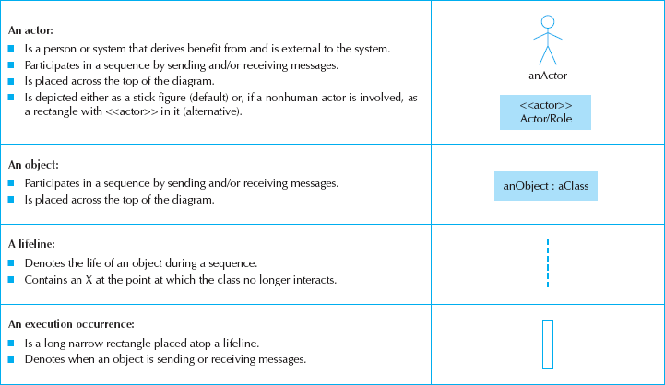
Sequence Diagram Syntax

Slide 10
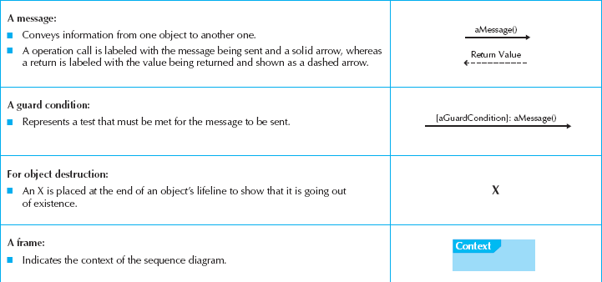
More Sequence Diagram Syntax
Return message can be omitted.
e.g., shopping cart in an eCommerce website
The time order of messages goes from the top to the bottom of the page, so messages located higher on the diagram represent messages that occur earlier on in the sequence, versus the lower messages that occur later.

Slide 11
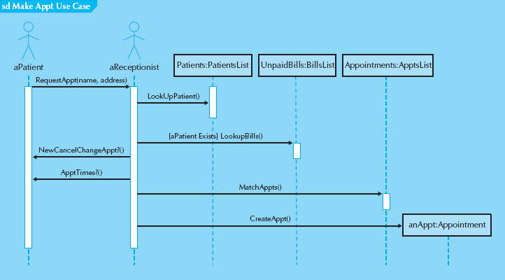
Sample Sequence Diagram
Actors and objects that participate in the sequence are placed across the top of the diagram.
Patients:PatientsList – Patients is an instance of the PatientsList class that contains individual patient objects.
At times a message is sent only if a condition is met. In those cases, the condition is placed between a set of brackets, [ ] {e.g., [aPatient Exists] LookupBills()}. The condition is placed in front of the message name. Don’t use in model for a specific scenario.
There are times that a message is repeated. This is designated with an asterisk (*) in front of the message name (e.g., * Request CD).
Sometimes, an object will create another object. This is shown by the message being sent directly to an object instead of its lifeline. In Figure 7-1, the actor aReceptionist creates an object anAppt.

Slide 12
Steps to Build Sequence Diagrams
Set the context
The context of the diagram can be a system, a use case, or a scenario of a use case. The context of the diagram is depicted as a labeled frame around the diagram
Identify which objects will participate
That is, the objects that interact with each other during the use-case scenario.
Set the lifeline for each object
draw a vertical dotted line below each class to represent the class’s existence during the sequence. Is the object no long need at the end? (x)
Lay out the messages from top to bottom of the diagram based on the order in which they are sent
draw arrows in order to represent the messages being passed from object to object in time, with the arrow pointing in the message’s transmission direction. Add parameters into parentheses after message name.
Add execution occurrence to each object‘s lifeline
draw a narrow rectangle box on top of lifeline to show sending/receiving message.
Validate the sequence diagram

Slide 13
Communication Diagrams
They can show how the members of a set of objects collaborate to implement a use case or a use-case scenario.
They can be used to model all the interactions among a set of collaborating objects, and portray how dependent the different objects are on one another.
It is essentially an object diagram that shows message-passing relationships instead of aggregation or generalization associations.

Slide 14
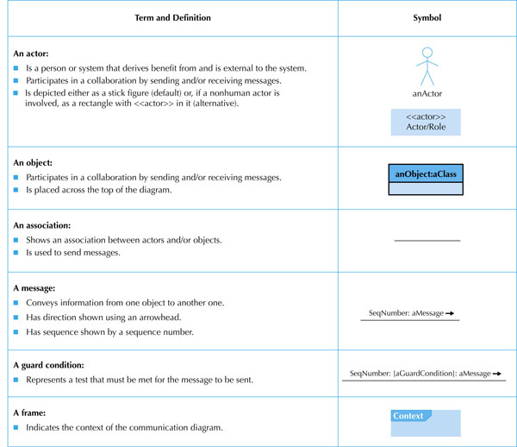
an undirected line (no arrow)

Slide 15
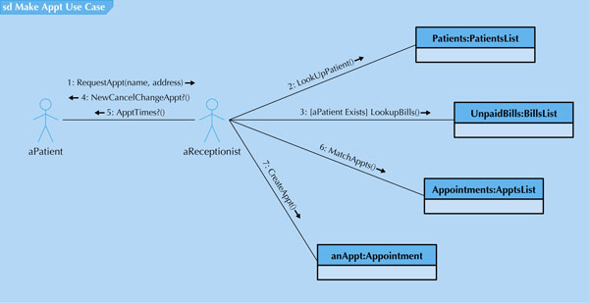
Sample Communication Diagram
When fully populated communication diagrams can be complex and difficult to understand. To simplify them, its objects can be logically grouped (package) together based on the messages sent to and received from the other objects.

Slide 16
Communication Diagrams vs. Sequence Diagrams
Both are dynamic behavioral models depicting objects interactions. However they are different in:
Communication diagrams emphasize the ﬂow of messages through a set of objects,
Sequence diagrams focus on the time ordering of the messages being passed.
Communication diagram never shows returns from message sends, whereas the sequence diagram can optionally show them.
Communication diagram does not have a means to explicitly show an object being deleted or created like sequence diagram.

Slide 17
Behavioral State Machines

Slide 18
Behavioral State Machines
A dynamic model that shows the different states through which a single object passes during its life in response to events, along with its responses and actions
Typically not used for all objects
Just for complex ones to help simplify the design of algorithms for their methods.
Different from interaction diagrams (sequence and communication)
should be used to help understand the dynamic aspects of a single class and how its instances evolve over time, and not with seeing how a particular use case or use-case scenario is executed over a set of classes.

Slide 19
Components of State Machines
States
values of an object’s attributes and its relationships with other objects at a point in time. E.g., patient state is new, current or former.
Events
Takes place at a point in time and change the values of the object’s attributes. E.g., a method call
Transitions
movement of an object from one state to another. Sometimes involve a guard condition (boolean expression include attribute values) to be true.
Actions
atomic, non-decomposable processes. Associated with transitions.
Activities
non-atomic, decomposable processes. Associated with states.

Slide 20
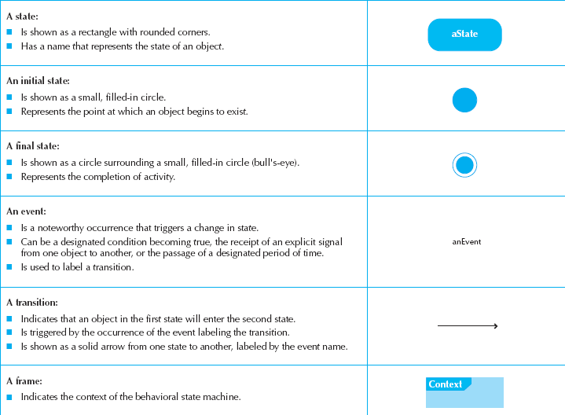
State Machine Syntax

Slide 21
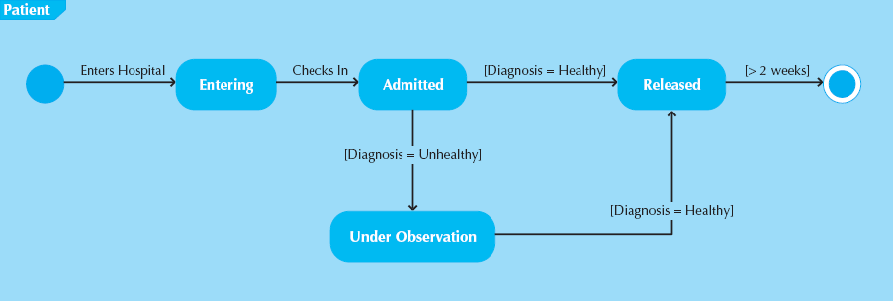
Sample State Machine
An example of a behavioral state machine representing the patient class in the context of a hospital environment.

Slide 22
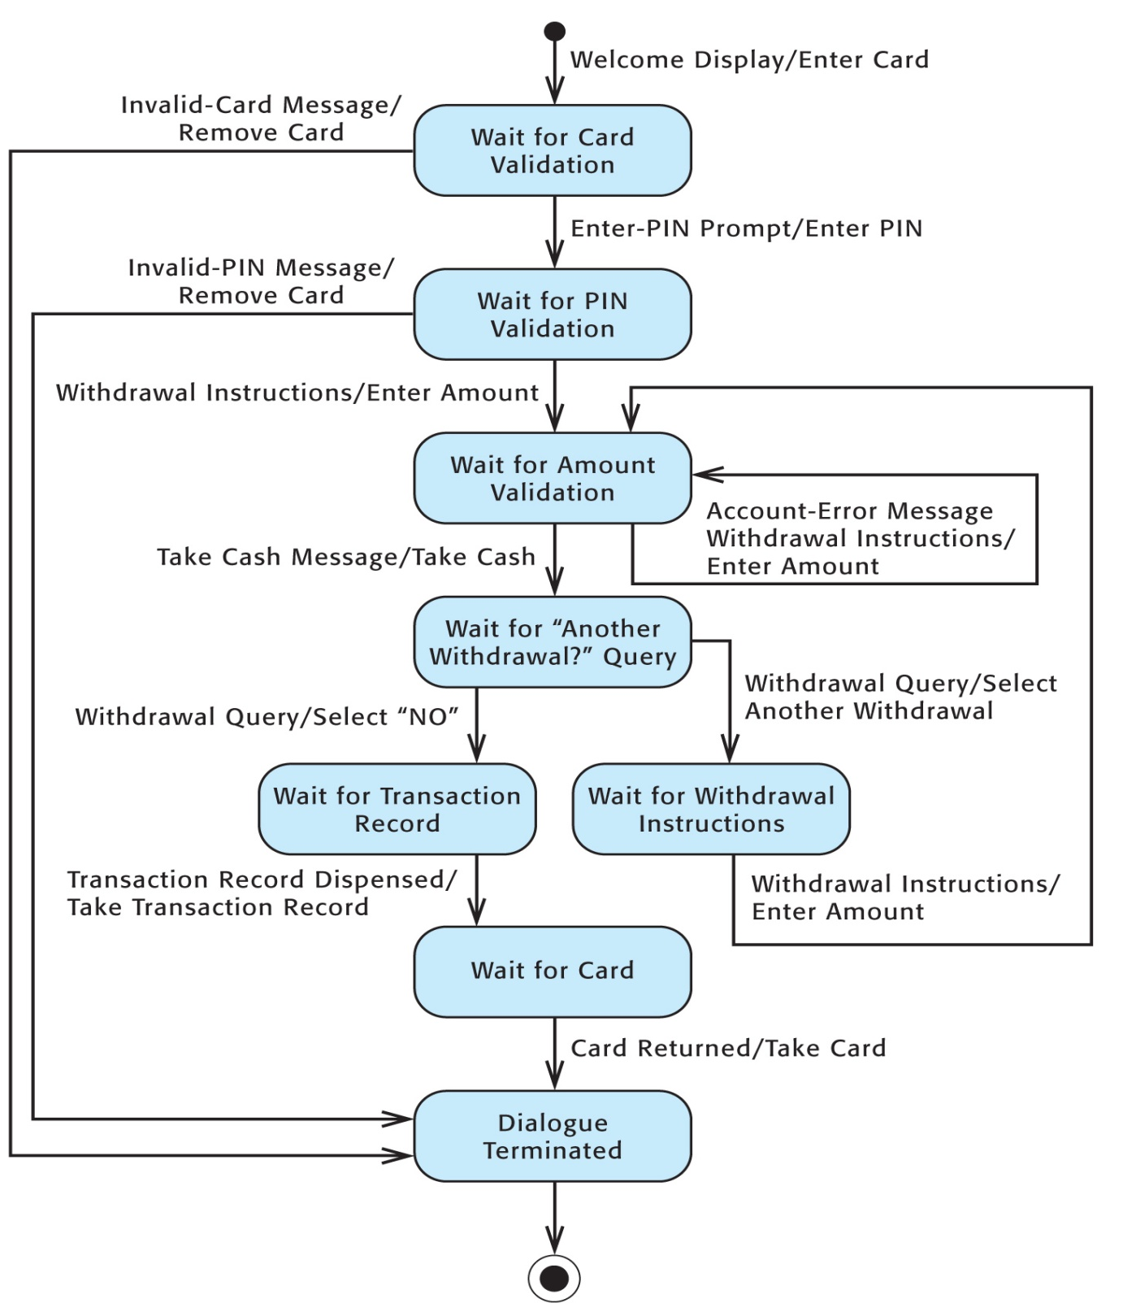

Slide 23
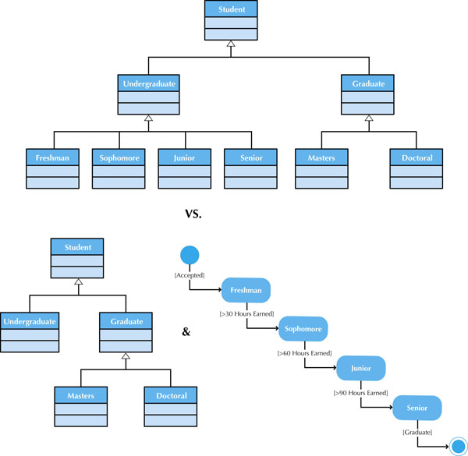
Figure 7-12 States vs. Subclasses

Slide 24
Steps to Build a State Machine
Set the context
Usually a class.
Identify the initial, final, and stable states of the object
Determine the order in which the object will pass through the stable states
the states are placed onto the behavioral state machine in a left-to-right order.
Identify the events, actions, and guard conditions associated with the transitions
What triggers attribute value changes, conditions, etc.
Validate the behavioral state machine

Slide 25
CRUD Analysis

Slide 26
CRUD Analysis
Labels object interaction in 4 possible ways
Create
Read
Update
Delete
Matrix representation of objects and interactions
Different from interaction diagrams or behavioral state machines, CRUD is most useful as a system-wide representation

Slide 27
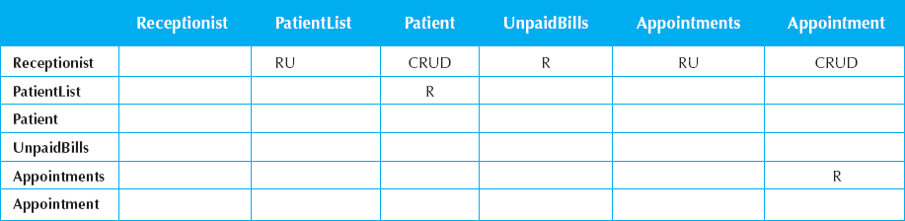
Sample CRUD Matrix
If a class represents only temporary objects, then the column in the matrix should have a D in it somewhere. Otherwise, the instances of the class will never be deleted.
CRUD analysis also can be used to identify complex objects. The more (C)reate (U)pdate, or (D)elete entries in the column associated with a class, the more likely the instances of the class will have a complex life cycle.As such, these objects are candidates for state modeling with a behavioral state machine.

Slide 28
Summary
Behavioral Models
Interaction Diagrams
Behavioral State Machines
CRUD Analysis

Slide 29
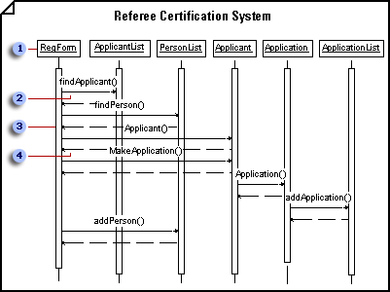
Sequence Diagram Example
Objects are represented as object lifelines, that is, in terms of their existence at a particular time. Adjust line length to indicate an object's creation or destruction.
Arrows represent messages between objects. An object can also send a message to itself.
Add an activation (also called a focus of control) to a lifeline to indicate the time period during which an object is performing an action.
A return message is shown as a dashed line.
Source: http://office.microsoft.com/en-us/help/sequence-diagram-example-HP001026029.aspx?CTT=5&origin=HP081550281

Slide 30
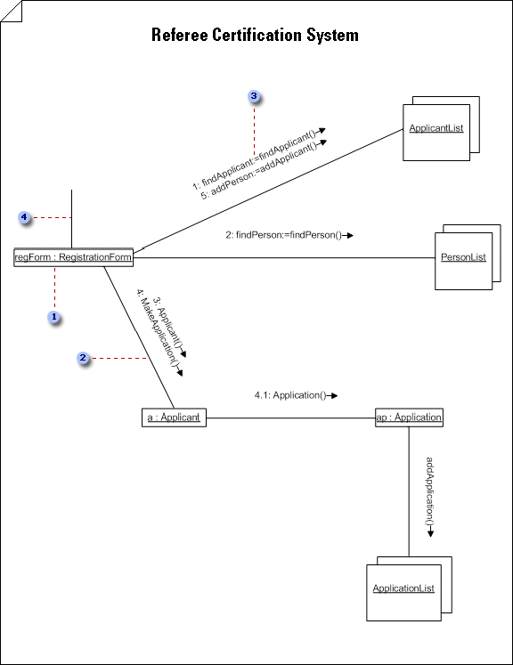
Communication Diagram Example
In a Classifier Role shape, the object's designator string is underlined to indicate that the object is an instance. You can also include the object name before the colon.
Callout 2 Links, or AssociationRole, indicate relationships and, with arrowheads, can also indicate navigability.
Callout 3 Double-click a link, then click Message to define a message that flows along a link. Number procedure messages in accordance with call nesting.
Callout 4 The first message always comes from outside the context you are including in the diagram.
Source: http://office.microsoft.com/en-us/help/collaboration-diagram-example-HP081550296.aspx?CTT=5&origin=HP081550281

Slide 31
Exercise: University Registration System
Use Case: Register for class
A student provides necessary information (studentID, courseNum, sectionNum, deptCode, term, year) for the class registration
Registration system
(1) checks whether the studentID is valid;
(2) creates a Student object and let it verify whether the student is in good standing;
(3) checks whether the deptCode is valid;
(4) creates a Department object and let it first check whether the course and section are valid, and then let it check whether the section still has seat. In order to check seat availability, the Department object needs to creates a Section object and asks it to answer whether the section is full.
(5) (if everything goes well) enrolls the student into the section

Slide 32
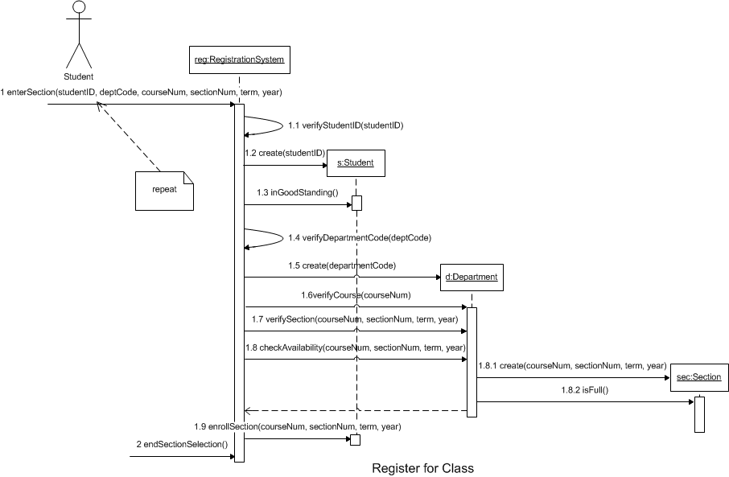
Sequence Diagram for Register for Class

Slide 33
Other Useful Tutorials:
Microsoft http://office.microsoft.com/en-us/visio-help/create-a-uml-sequence-diagram-HP081550391.aspx
UML-diagrams.org http://www.uml-diagrams.org/sequence-diagrams.html

